Slide 1
Greedy Principal Flows
A0164657U Sebastian Lie
Supervised by prof yao zhigang
Notes:
Good morning Prof Yao, Prof Choi and fellow students: I am Sebastian Lie, and today I will
Be sharing about my final year project, titled greedy principal flows.

Slide 2
Flow of Presentation
Motivation and Goal
Definitions
Literature Review
Principal Flow Algorithm
Results
Future Work
We are here
Notes:
Before we go into the presentation, let me first take us through the flow of this presentation.
First I will talk about the motivation behind this thesis, then the goal of research here.
Next, I will cover some definitions of terms and concepts we will use in this presentation
Then, I will be going through the literature review, where I introduce and explain some
Popular unsupervised learning methods.
After that, we will go into the central part of this presntation, explaining our greedy principal flow
Algorithm
Then I will spend some time to elaborate on the results obtained when the algorithm is run on real world data,
Before finishing with future directions of research.

Slide 3
Motivation and goal
Notes:
First, our motivation and goal.

Slide 4
Motivation
Rising Popularity of Big Data
The Manifold Hypothesis₁
Extending PCA to manifolds more simply
Notes:
3 main points motivated this thesis:
With the increase in computing power and the availability and popularity of big data, there are now a multitude of
Multivariate datasets available to us for analysis
While using datasets to predict some quantity or the class of some unseen data is very popular,
we can also use these datasets in a more subtle, but no less important way: to discover patterns in the data and glean more information from it: which is known as unsupervised learning.
And this of course leads into the 2nd motivation for this thesis:
The manifold hypothesis.
It states that natural data forms lower-dimensional manifolds in its embedding space.
What if the many multivariate datasets available to us
were perhaps sampled from some lower dimensional manifold,
And more interestingly resided in non-Euclidean space?
If this was true, then methods like principal component analysis,
Which assumes the data is sampled from Euclidean space, would not be very effective,
And could be further improved if we considered extending it more naturally to manifolds.
And this has been done: principal flows was created by prof yao
Which did extend the concept of PCA to manifolds
but it was solved using variational calculus, which is the calculus of functions.
Thus the question was:
Could we create principal flows more simply?
And could this simpler method actually function as we wanted it to?
What information could it glean from datasets?

Slide 5
Goal of this Research
Simplify
Use a greedy approach to the constructing principal flows.
Focus
Focus on the 1st principal flow.
Assume all data lies on some d-dimensional hypersphere of radius 1, embedded in a D-dimensional space.
How would this new method describe various, popular multivariate datasets? Could it find novel patterns of variation?
Investigate
Notes:
Then, the goal of this thesis, succinctly put, is to:
Simplify, focus and investigate.
To simplify the original principal flow algorithm, we turn to using a greedy approach to constructing principal
Flows instead of using variational calculus.
Focus: the principal flows are like the manifold extension of pca, and their exact definition will be explained later, but like pca
If the data is in d dimensions, then there are d principal flows. In this thesis, we concentrate on only the first one.
Additionally, we assume that all data is sampled from some hypersphere with radius 1. the significance of this will be explained later on in our
Section explaining our algorithm.
Investigate: we want to investigate how our new algorithm would perform on real world data and
Observe if it could find new patterns not seen before in the data

Slide 6
Definitions
Notes:
Now we move on to definitions

Slide 7
Flow of Presentation
Motivation and Goal
Definitions
Literature Review
Principal Flow Algorithm
Results
Future Work
We are here

Slide 8
Vector Fields
Geodesics
Exponential Maps
Tangent Space
Definitions
Notes:
This is the order of definitions we will go through:
Assumed knowledge: eigenvectors, eigendiagonalisation
We note that the definitions will be slightly informal,
And will focus more on the intuition of the concepts than their
Exact definitions,
since some of the concepts here are quite difficult and abstract.

Slide 9
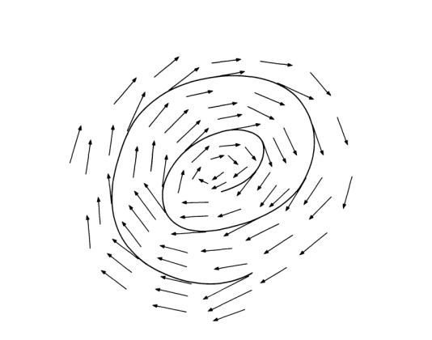
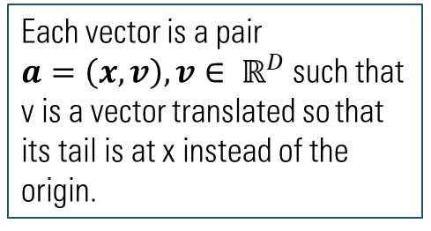
Vector Fields
Each vector is a pair
$a=\left(x, v\right), v∈ ℝ^{D}$ such that v is a vector translated so that its tail is at x instead of the origin.
An example of a vector field
Notes:
First let us talk about vector fields, which is illustrated by the image in the slide
Each vector in the vector field, represented by the arrows here,
Are pairs a =…. Such that v is a vector translated so that it’s tail is at x instead of the origin.
Then A vector field in the context of the diagram is a function
that will assign to every point a vector which points in the direction the spiral is moving:
That is from the outer part of the spiral to the inner part.
We will mention vector fields later on when defining what our principal flow is.

Slide 10
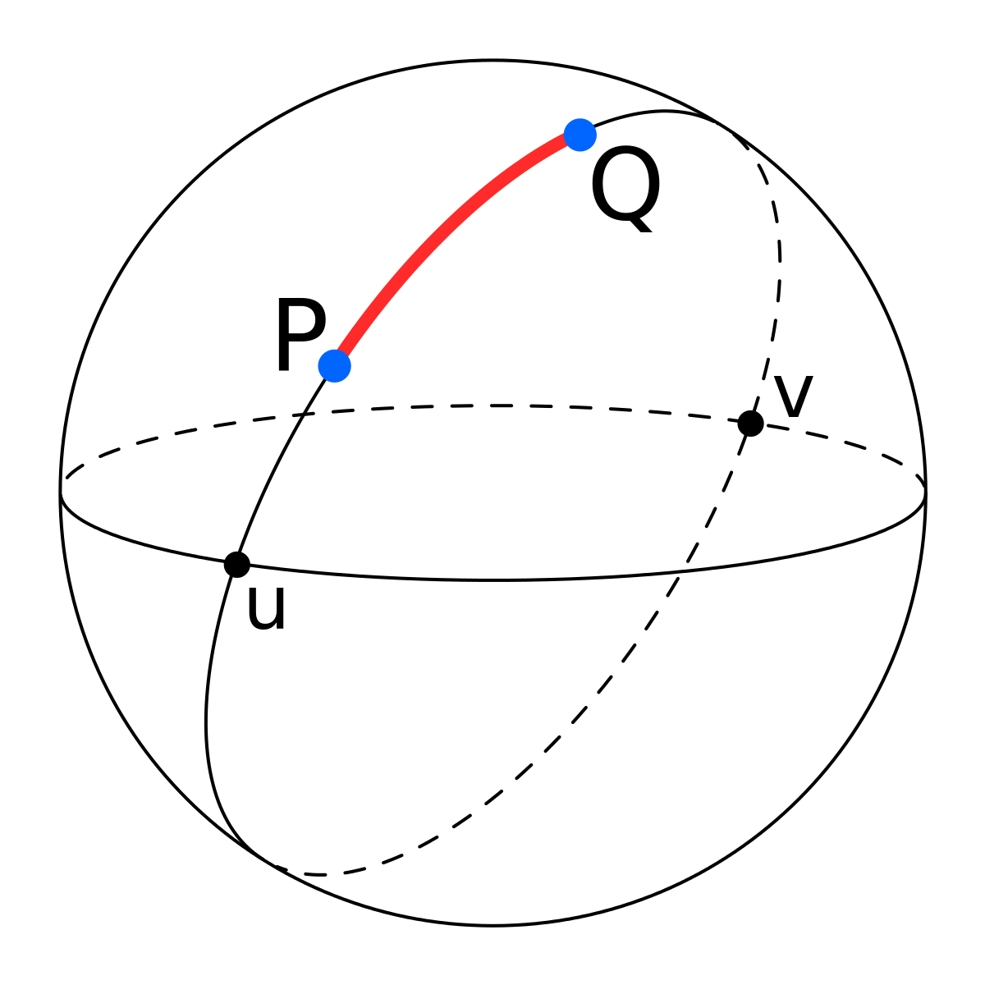
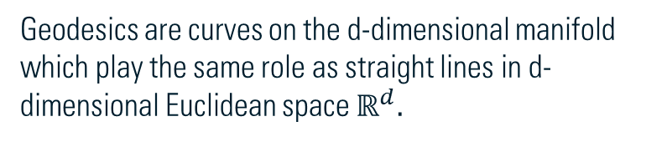
Geodesics
Geodesic between P and Q
Geodesics are curves on the d-dimensional manifold which play the same role as straight lines in d-dimensional Euclidean space $ℝ^{d}.$
Notes:
Now let us talk about the concept of geodesics.
Geodesics are curves on the d-dimensional manifold which play the same role as straight lines in d-dimensional Euclidean space $ℝ^{d}.$
As an example, consider the 3-dimensional sphere. Then the arc between P and Q,
Illustrated in red on the diagram, Is the geodesic between P and Q
And the arc length between P and Q is the geodesic distance, an extension of Euclidean distance to
Manifolds.
We will see some unsupervised learning methods try to approximate geodesic distance later on.

Slide 11
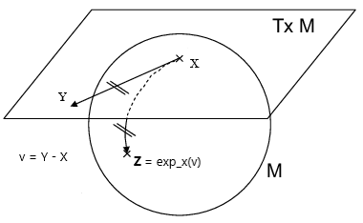
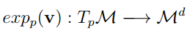
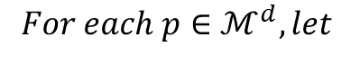
Exponential Maps
$${For each p∈ℳ}^{d}, let$$
Notes:
Next we talk about exponential maps.
In this presentation and in the diagram, we talk specifically
About the exponential map for the hypersphere even though in general, the
Exponential map is not restricted to the hypersphere.
For the sake of illustration, let us consider sphere in 3 dimensions. X is a point on the sphere,
Where the plane meets the sphere. Or in other words, the plane is tangent to the sphere at X.
Let v be a vector v = Y- X for a point Y on the plane which we wish to project onto the 3 dimensional sphere. Then the exponential map moves along the geodesic on the sphere
Which is represented by the dotted curve on the sphere that mirrors the direction of v on the tangent plane and finds the projection of Y on the sphere,
Represented by Z.

Slide 12
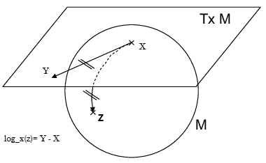
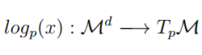

Logarithm Maps
$$For each x∈ ℳ^{d},$$
Notes:
Log maps are the inverse of the exponential map: given some point z on a 3 dimensional sphere
With the plane tangent to the sphere at point x.
We can use log map or log_x(z) to obtain the vector that tells us how to move to the
Projection of Z on the plane: Y.
This means it finds the vector on the plane that mirrors the geodesic going from X to Z:
This is represented by the solid line on the plane.
This vector indicates the direction in which x should move to obtain the projection of Z
On the plane: Y.
Thus in summary, the exponential map takes a vector but produces a point, whereas the log map
Takes a point and produces a vector.

Slide 13
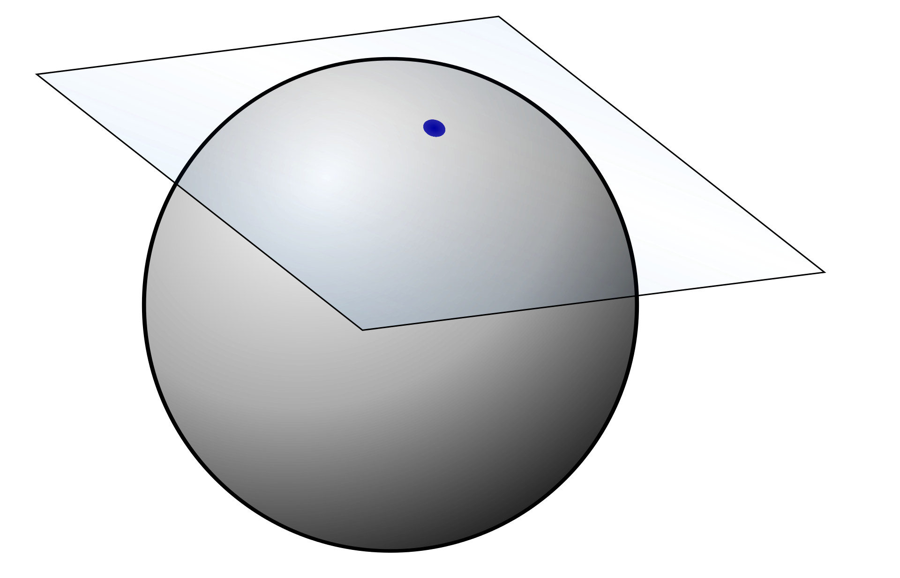
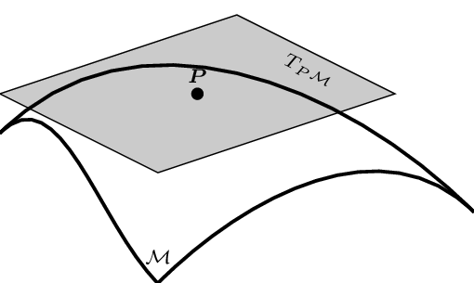
Tangent Space
p
We refer to the plane tangent to the sphere in the diagram above as the notion of tangent space that we use in this presentation.
Notes:
Finally, tangent spaces.
Let the sphere from diagram on the left be the manifold, and let the blue point be p. Then the plane tangent to the sphere at p is the tangent space. Any vectors on this plane lie in the tangent space. Then the exponential map would project points from the plane down onto the sphere, while the log map would project points from the sphere up to the plane.
This is the intuition of the tangent space which we will be working with throughout this presentation.
Note that although we specify the manifold and tangent space in three dimensions here,
we can generalise this to d dimensions, with the manifold as the hypersphere in d dimensions, while the tangent plane is the hyperplane. These are the definitions of our manifold and tangent space we will use when we talk about principal flows later on in this presentation

Slide 14
Literature review
Notes:
Now we move on to the literature review.

Slide 15
Flow of Presentation
Motivation and Goal
Definitions
Literature Review
Principal Flow Algorithm
Results
Future Work
We are here
Notes:
This is just a reminder of where we are in our presentation.

Slide 16
Literature Review
Non-Linear
Isomap
PCA
LLE
Linear
Unsupervised learning
PGA
Notes:
This is an overview of the Unsupervised learning methods we will be talking about today:
I have split them up into whether they used linear methods and thus were only able to capture linear
Patterns or whether they were able to capture some non-linearity in the dataset.
We will first cover linear methods before moving on to non-linear methods.

Slide 17
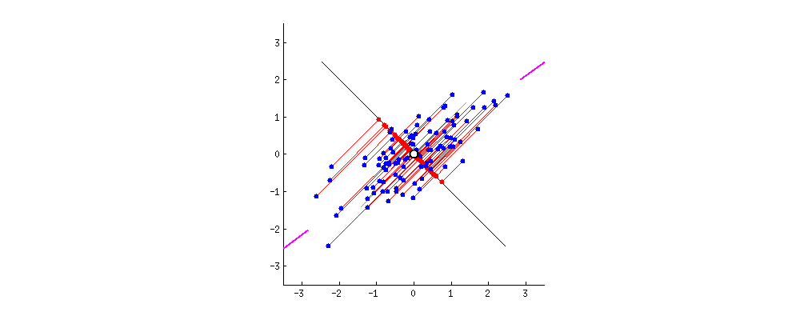
Principal Component Analysis (PCA)
PCA in 2 dimensions
Idea: obtain a lower-dimensional representation of the data that retains as much variation as possible present in the data set.
Principal Direction: Black line in diagram when it stops at magenta ticks.
Notes:
Principal component analysis or PCA is an unsupervised learning method usually used for visualisations
Or for reducing the dimensionality of the dataset.
The idea of PCA is to obtain a lower-dimensional representation of the data
that retains as much variation as possible present in the data set.
This means that PCA
finds directions such that the variance of the projections onto this direction is maximized,
This is represented in the animation as the spread of the red dots on the black line.
And this can be shown to be equivalent to minimizing the distance between the original point
And its projection. In the animation, this is represented by the red lines between the blue dots,
the data points, and the black line.
The black line represents the principal direction, the direction onto which data is projected to obtain the 1st PC.
The principal component is given by the red dots along the principal direction
When it stops at the magenta ticks.
PCA relies on constructing these principal components: new variables that are linear combinations of the original variables that have first been centered.
These principal components are uncorrelated (orthogonal) and ordered in descending order
by the amount of variability of the original data retained.
Thus, PCA finds a lower dimensional embedding by computing the first d principal components.
They are constructing by: centering the data matrix, then computing
The covariance matrix of the centered data matrix, then the eigendiagonalisation of C, and obtain Vd, the d eigenvectors associated with the d largest eigenvalues.
These d eigenvectors are the d principal directions
Finally, we obtain the d PCs by computing the matrix multiplication between the data
Matrix and the d eigenvectors. XVd.

Slide 18
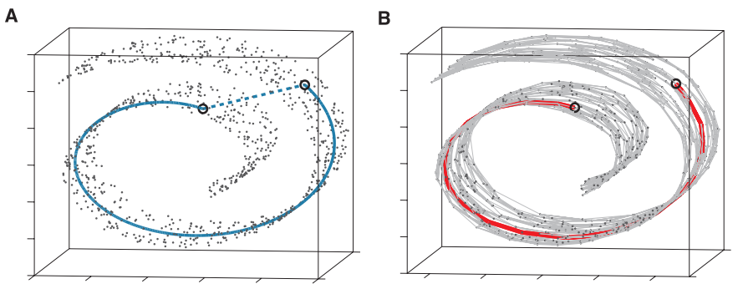
Isomap
Idea: extend Multi-Dimensional Scaling to manifolds by optimizing embeddings to preserve geodesic distances between pairs of data points.
Not using K nearest neighbors:
Shortcutting manifold: WRONG!
Using K nearest neighbors:
Approximates geodesic distance CORRECTLY!
Notes:
Isomap is a non-linear unsupervised learning method that computes a lower-dimensional embedding
of a set of high-dimensional data points.
this is usually used for visualising the high dimensional data.
The idea behind this method is to extend another linear method, Multi Dimensional Scaling, to manifolds
By optimising embeddings to preserve geodesic distances between data points.
Isomap achieves this by relying
on the fact that for neighboring points, input-space distance provides
a good approximation to geodesic distance. For faraway points,
Isomap approximates geodesic distance by adding up a sequence of
“short hops" between K neighboring points, computed efficiently by finding shortest paths in a graph with edges connecting neighboring data points.
Using these K neighbouring points is key as shown in the diagrams: in A
Without using some K nearest neighbours, we might “shortcut” the manifold:
And this means that
The distance between the 2 points circled would then be approximated by the dotted line,
Which does not correctly represent the geodesic distance, since the geodesic distance should be the length of
Some curve on the manifold, and the dotted line is clearly not: there should not be a path there.
In B a point in the graph we construct is only connected to its K nearest neighbors,
And so through a sequence of “hops” on the graph we reach the point on the other side of the manifold:
Using the path in red, which is on the manifold.
This correctly approximates the geodesic distance between the 2 points.
Then the isomap embedding is computed by first constructing a graph, with nodes
As data points. Nodes are connected if they are each other’s K nearest neighbours,
With a weight corresponding to the Euclidean distance between points.
Then we compute all pairs shortest paths on this graph, and obtain the matrix of shortest
Distances between points, which approximates geodesic distance.
Then we apply multi dimensional scaling on this matrix to
Obtain our lower dimensional embeddings.

Slide 19
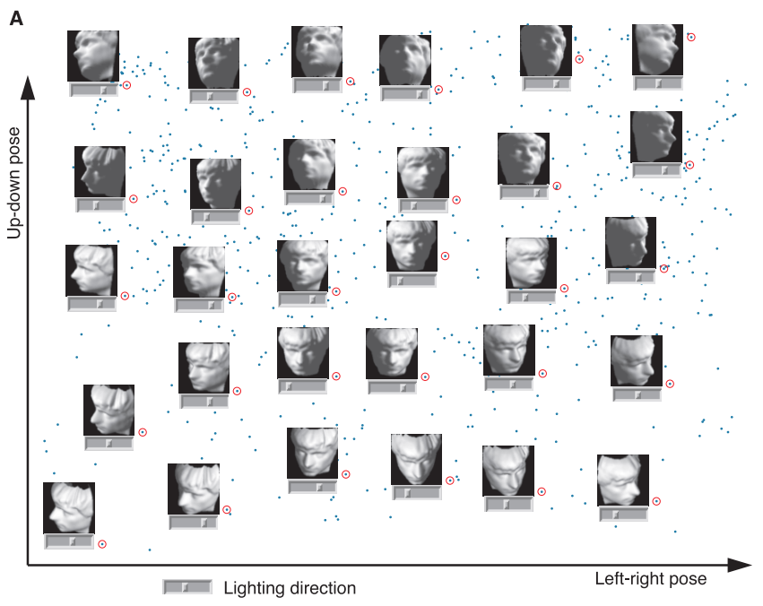
Isomap - Results
Notes:
This picture illustrates the results isomap obtains: it is able to
Find a 2 dimensional representation of these stone faces at different angles
That makes intuitive sense: pictures where the face is turned to our left is
On the far left in this embedding, and pictures where the face is turned to the right
Is on the far right.

Slide 20
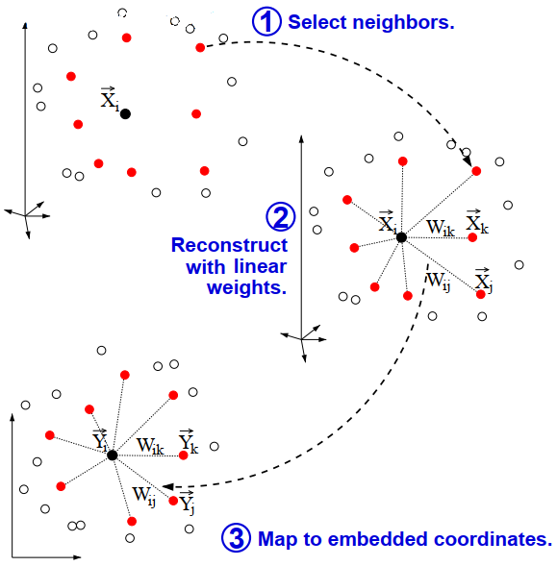
Locally Linear Embedding (LLE)
Idea: Construct a mapping from the higher dimensional data to the lower dimensional reconstructed points that preserves the local configurations of each point’s nearest neighbors.
Notes:
Next we talk about LLE.
LLE, like isomap is a non-linear unsupervised learning method that computes a lower-dimensional embedding
from a set of high-dimensional data points and is also usually used for visualising high dimensional data.
However, they rely on different ideas.
Locally, LLE assumes the embedding is linear, and for each data point, LLE uses a linear combination of its K nearest neighbours to reconstruct a lower-dimensional point, Y.
The diagram on the slide succinctly shows us the process of LLE.
LLE like isomap begins by finding a set of the nearest neighbors of each point,
illustrated by the points in red.
It then computes a set of weights, Wij, for each point that best describes
the point as a linear combination of its neighbors.
Finally, it uses an optimization technique
to find the lower-dimensional embedding of points using Wij,
such that each point is still described with the same linear combination of its neighbors.

Slide 21
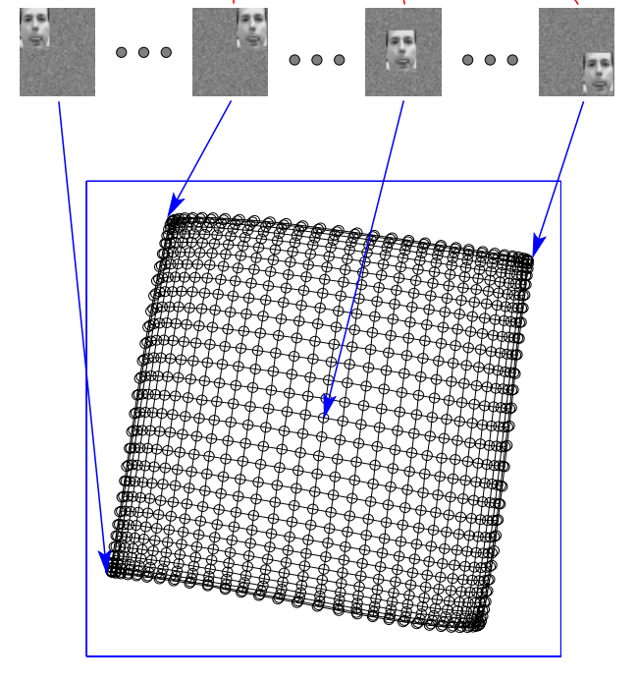
Locally Linear Embedding - Results
LLE is able to find a mapping that makes intuitive sense.
Notes:
Here we show some results of LLE.
We can see that the picture with the face in the centre is mapped to
A point in the center of the embedded space,
And the pictures with the face in the corner are mapped to the corners of the space.
Most notably, pictures with the face at opposite corners are mapped to points at
Opposite corners in the space.

Slide 22
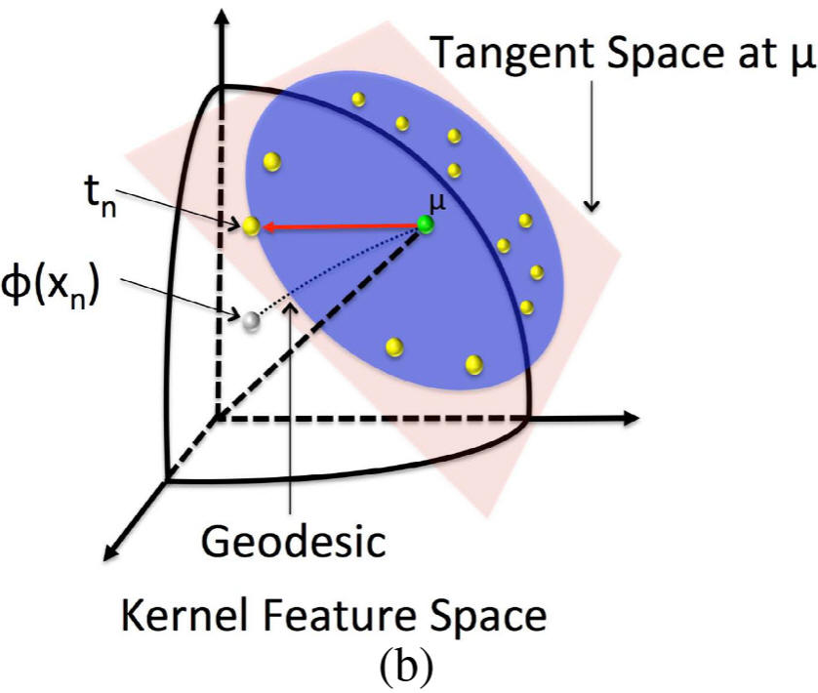
Principal Geodesic Analysis (PGA)
Idea: generalization of PCA to manifolds.
The main aim of PGA is to describe the variability of some D dimensional data that lie on a d dimensional manifold.
Notes:
Finally, let us talk about principal geodesic analysis.
PGA aims to construct some principal geodesics that are analogous to principal directions in PCA: the directions along which data is projected.
Instead of finding the principal geodesic however,
The authors of this method prove that we can approximate the d geodesics
along which maximal variation lies by projecting data from
Some manifold to the tangent space at the intrinsic mean of the data, represented by the miu in the
Diagram, and then finding the d eigenvectors associated
with the d largest eigenvalues of the covariance matrix of the projected data on this hyperplane.
This intrinsic mean is calculated by iteratively setting miu to be the average of vectors on the plane
obtained through the log
Map and projecting back to the manifold using the exponential map.
PGA has been used in statistical shape analysis to describe the variability of a population of geometric objects particularly in the field of image processing in Medical imaging.

Slide 23
Greedy principal flows
Notes:
Now we move onto the main part of our presentation: describing and explaining our algorithm.

Slide 24
Flow of Presentation
Motivation and Goal
Definitions
Literature Review
Principal Flow Algorithm
Results
Future Work
We are here

Slide 25
Greedy Principal Flow – Flow of explanation
Principal Flow Definition
Centroid Finding Algorithm
Greedy Principal Flow Algorithm
Extension:
Greedy Principal Boundary
Notes:
This shows the flow of our explanation:
First we will define principal flows. Next, we will
Outline an algorithm to find the centroid of some data
That we assume lies on the hypersphere. Next we will
Elaborate on the greedy principal flow algorithm and explain how it works.
Finally we will explain an extension to the greedy principal flow:
The greedy principal boundary.

Slide 26
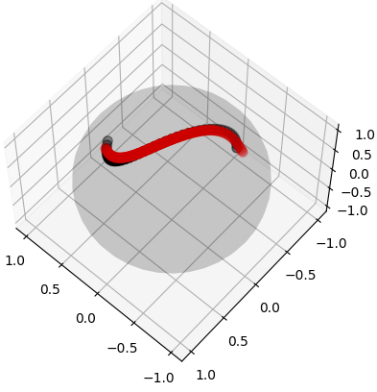
Principal Flows- Definition
The main objective of principal flows is to describe multivariate data on the manifold
Is a path which at every point is tangent to the direction of maximum variance.
It is able to describe data by finding patterns of variation in the data.
Notes:
The main objective for greedy principal flows is to quantify or describe multivariate data:
By showcasing patterns of variation in the data.
However, we cannot simply fit a line, as this is not Euclidean space.
Thus the principal flow is a curve on the manifold passing through the mean of the data
that is always tangent to the direction of maximal variation of the data at any given point it contains.
This path flows outward from the center of the principal flow, the centroid of the data as in the Diagram.
The vectors tangent to every point of the principal flow forms a vector field,
Illustrated by the arrows on the red curve.
and each points in the direction of maximum variance
It extends the notion of principal component analysis (PCA) to multivariate datasets that satisfy nonlinear constraints and thus lie in non-Euclidean space.
Then the principal flow is an extension to PCA not because it is a non-linear dimension
Reduction method, but because it is able to find paths that can be thought of as
The extension of principal directions in Euclidean space.
We note again that we are only focused on the first order principal flow, which is akin to
The first principal direction.

Slide 27
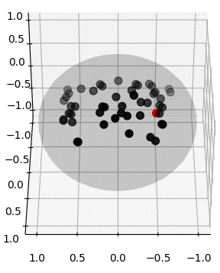
Centroid Finding
Idea: We first need to establish our starting point.
Animation of first 50 iterations
Notes:
Before we get into our principal flow algorithm, we first need to establish our starting point,
the centroid of the data. Thus, we first aim to estimate this centroid and use it as a starting point. Although there are many ways of doing this, including the method to find the intrinsic mean in PGA, we opt to make use of the fact that the first principal direction passes through the centroid of the data. Thus, if we iteratively project all the data onto the tangent space of the hypersphere, find the 1st principal direction of that data, and move in that direction, and find the projected point on the hypersphere, we will eventually converge on the centroid
Of the data on this hypersphere.
An illustration of the algorithm is provided as an animation.

Slide 28

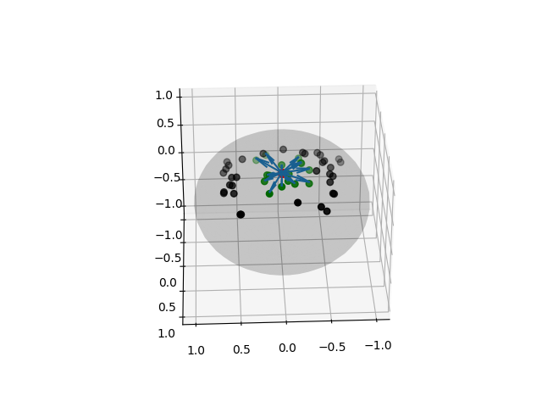
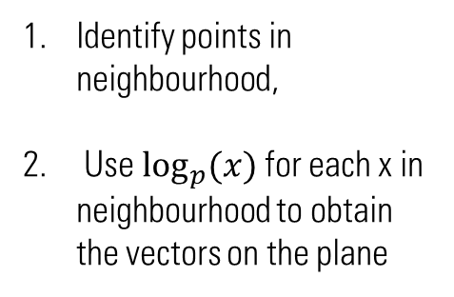
Greedy Principal Flows – 1st Iteration
2.
1.
Identify points in neighbourhood,
Use $\log_{p}{(x)}$ for each x in neighbourhood to obtain the vectors on the plane
Red -> p, Centroid, Initial Point of Flow. Blue -> Plane vectors. Green -> Points in neighbourhood.
Notes:
Now we move on to explaining the greedy principal flow algorithm.
For simplicity, we illustrate our algorithm in 3 dimensions.
We note that this explains the algorithm from the 1st iteration.
First, we start at diagram 1.
We want to project our data, the black dots in 1.
onto the plane tangent to the sphere at the centroid, p.
Here we may choose to project all our data, or use a kernel function, K to weight our data so that more emphasis is placed on points in some neighborhood around our centroid, whose size is controlled by scale parameter h, than outside it. Intuitively, h controls how sensitive the principal flow is to local data.
For this illustration, we use the binary kernel which weights points as one or zero depending on their distance from p.
Using our binary kernel, we first identify the points in green: points in a neighborhood around
The centroid, and then we compute the log map of these points at p, the centroid,
And obtain vectors on the plane tangent to the sphere at p represented by the blue arrows.

Slide 29
Greedy Principal Flows – 1st Iteration
2.
2a.
Plane tangent to sphere at p
p
Notes:
This diagram illustrates a simplified but closer top down view of the plane vectors, expanding on diagram 2,
With green points as points in the neighbourhood and blue arrows as vectors in the plane.

Slide 30
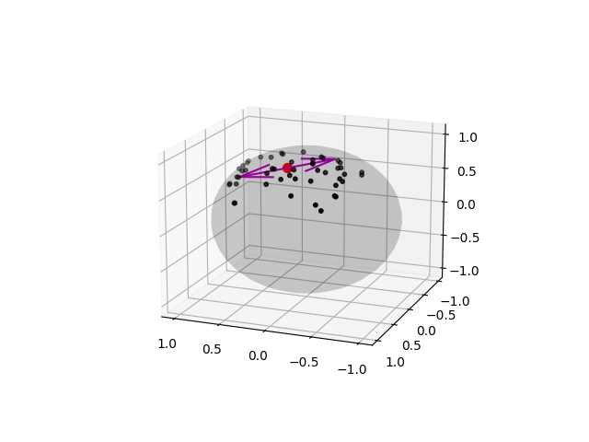
Greedy Principal Flows – 1st Iteration
2a.
3.
Plane tangent to sphere at p
Obtain Covariance matrix from plane vectors.
Diagonalise that matrix and obtain
the first principal direction.
p
Magenta -> Principal Directions.
Notes:
Then, we compute the covariance matrix of the points in our
Neighborhood using our plane vectors.
We then perform eigendiagonalisation of the covariance matrix and take the eigenvector v1 corresponding to the largest eigenvalue λ1. This indicates the direction of the principle flow and is our principal direction. Here, λ1 corresponds to the amount of variance of our data in the direction of v1. This is where the “greediness" in our algorithm lies: since we choose at each step, the direction of maximum variance.
Since we are on the first iteration, we only have 1 point on the principal flow:
The centroid, and thus we move in 2 directions from this point: the principal direction and
Its opposite direction, indicated by the arrows in magenta.

Slide 31
Greedy Principal Flows – 1st Iteration
3a.
Plane tangent to sphere at p
p
Notes:
Here as before we illustrate how the principal directions would look like on the plane.

Slide 32
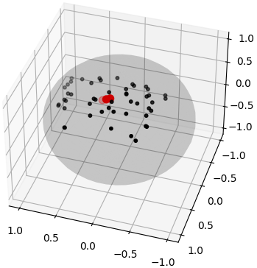
Greedy Principal Flows – 1st Iteration
4.
3a.
3b.
Plane tangent to sphere at p
Plane tangent to sphere at p
p
p
Move in both directions indicated by vectors in magenta.
Project points back to manifold.
Notes:
Moving in both directions indicated by the magenta arrows
we collect two points: one point when we move a step in the principal direction, and the other when we move a step in the opposite of the principal direction. We then project both points back onto the manifold,
Using the exponential map.
Obtaining diagram 4. This is the end of the 1st iteration. From this iteration onwards,
We repeat steps 1 and 2 for each end of the current principal flow and obtain

Slide 33
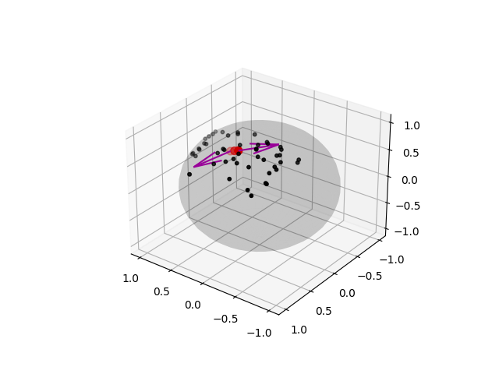
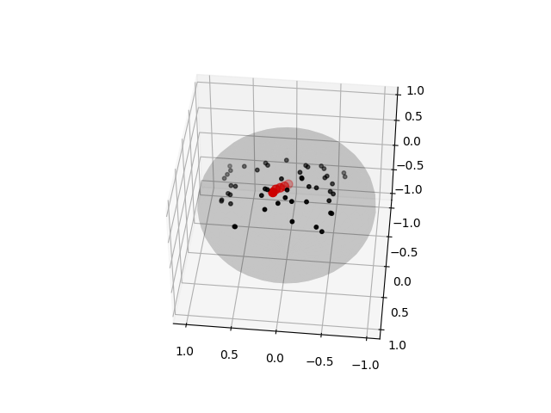
Greedy Principal Flows – k^{th} iteration
5.
6.
From each end, move in both directions.
Project points back to manifold.
Notes:
Diagram 5. Here the principal directions at each end of the principal flow are in magenta.
As before, we now move a step in each principal direction, then project both points back onto the manifold using the exponential map. We repeat the procedure above until the maximum iterations is reached.
This is how the greedy principal flow is constructed.

Slide 34
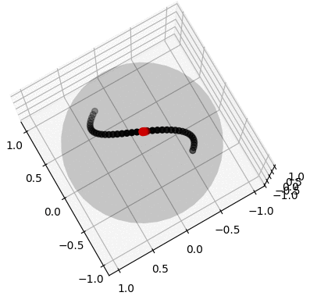
Greedy Principal Flows – Illustration
Animation of Principal Flow on S-shaped Toy Data
Notes:
Putting it all together, this is an illustration of
our greedy principal flow algorithm, here is the algorithm
Being run on S-shaped toy data.
Notice how it starts at the center and flows outwards. At each iteration,
2 new points on both ends of the principal flow are added.

Slide 35
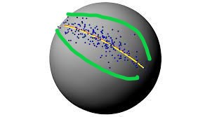
Extension: Greedy Principal Boundary
Boundary
As an extension, we can imagine an ellipse around the data: this forms what we can compute as the principal boundary.
User defined radius.
Direction determined by 2nd eigenvector from diagonalization.
2nd eigenvector from diagonalisation
Notes:
Next, we extend the idea of principal flows to attempt to find some boundary of the data.
Let us assume that the data is contained in some ellipse on the hypersphere, or in the
Case of this diagram, the sphere. Then our aim is to find some boundary around this ellipse, illustrated in green. We proceed similarly to the principal flow, except that we now save the eigenvectors corresponding to the
2 largest eigenvalues when we diagonalise the covariance matrix,
At each iteration, the boundary is calculated by moving a distance
(which is the user defined radius) in the direction of
The 2nd eigenvector orthogonal to the principal flow that approximates the radius of the ellipse that contains the data, X.
And this is how the principal boundary is constructed in tandem with the principal flow.

Slide 36
Results
Notes:
Now we move on to the results of applying our greedy principal flow.

Slide 37
Flow of Presentation
Motivation and Goal
Definitions
Literature Review
Principal Flow Algorithm
Results
Future Work
We are here

Slide 38
Results
Real World Data
MNIST
Fashion MNIST
Faces In the Wild
Olivetti Faces
Notes:
We go through different kinds of real world data, from the
MNIST datasets to facial data sets

Slide 39
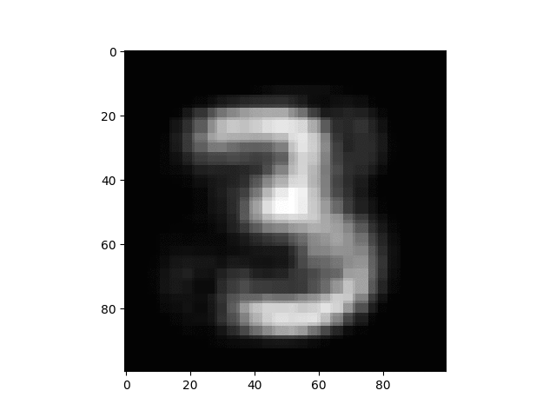
MNIST
All the images obtained are “nice“ representations of 3s.
Digits slowly rotate to slant to the right.
Principal flow describes variability present in the among “nice” digits.
Sequence of digits also translates to some real world meaning.
Notes:
First we show our results on the MNIST dataset, a dataset of handwritten digits,
Specifically we show our results when our algorithm is run only on the digit 3.
These images animated into a gif on the right, are points from the greedy principal flow using the binary kernel: they go from the start to the end of the principal flow obtained.
We observe that all the images obtained from the
Principal flow are “nice" representations of 3s, in that they cannot be confused with any other digit,
and they seem to be quite neatly written.
Our principal flow algorithm obtaining these representations suggests that it has found some path through the data that has intuitive meaning: the images from this path are easily discernible,
and seems to validate our choice of a hypersphere for our manifold, since data that intuitively should be “near" each other, such as 3s that look the same, are indeed close on the manifold.
And here we can see the principal flow describe to us the variability within these nice 3s:
the slant of the digit. We can see that the digits start out leaning left, then slowly rotate to slant to the right, going through a phase of being perfectly centered.
Additionally, this gradual change in orientation of the digit along the curve
suggests that our greedy principal flow is able to find a central
path that not only describes variability present in the data, but that also translates to some real world meaning, as it continually tilts to the right.
From our results from the MNIST data, we can see that our greedy principal flow can be used to understand our data better, and seek out some patterns of variation that we might otherwise be oblivious to.

Slide 40
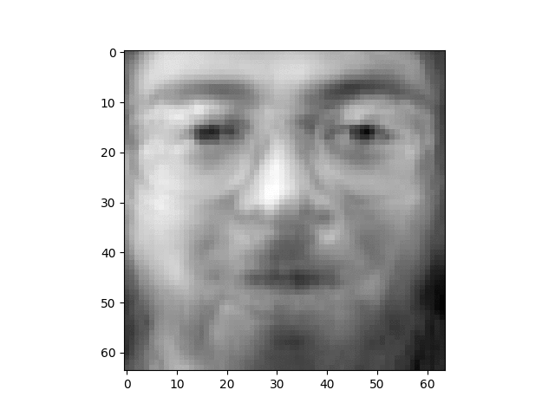
Olivetti Faces
Features and angle of faces gradually transition
Main source of variability: angle of face, presence of glasses and beard.
.
Principal Flow produces a sequence with intuitive meaning that follows human logic.
Notes:
Now we display the results of running our algorithm on the olivetti faces dataset:
a set of facial images taken at AT&T Laboratories Cambridge.
Here once again the animation in the slide shows the images obtained
From the principal flow from start to end, and begins with the bearded man with glasses
Directly facing the camera.
We can see that the principal flow obtained contains clear pictures of faces, albeit with the bottom half of their faces slightly blurred. This again echoes what we saw with the MNIST data:
That we are able to obtain nice representations of data from the principal flow.
As with our results from the MNIST data, we can glean meaning from
neighbouring images on the curve: they are close to each other in a meaningful way.
This can be seen from how the set of faces start out
Facing us, but gradually transition to being slightly tilted away,
With their faces going through different angles.
It also shows that our principal flow is able to find a path on the hypersphere that makes real-world sense: faces on the curve transition from one angle to another and remain at that angle without jumping back and forth between facial angles. This again validates our choice of using
The hypersphere as our manifold, since faces near to each other face the camera at similar angles,
Which makes sense.
Observing the images closely, we can see that these faces differ the most in the angle of their face, whether they wear glasses, and whether they have a beard.
We observe that the pictures on our flow seem to be mostly of men.
Thus, It seems like our principal flow captures the variability between men
more so than between men and women. However, there could be a logical reason for this.
Facial images of men without glasses or a beard differ more from
a facial image of men with these features than images of women would, especially since these photos are focused only on a person’s face.
This shows that our greedy principal flow is able
to describe the variability in the dataset that makes intuitive sense in the real world.
Thus we can see that while our greedy principal flow incorporates mostly local information i.e the faces in some neighbourhood around our current flow point, the flow obtained is also open to a more global interpretation: we can see the faces transition through different angles, tilting in the same direction continuously,
and watch as it describes to us the main sources of variation in the data set.

Slide 41
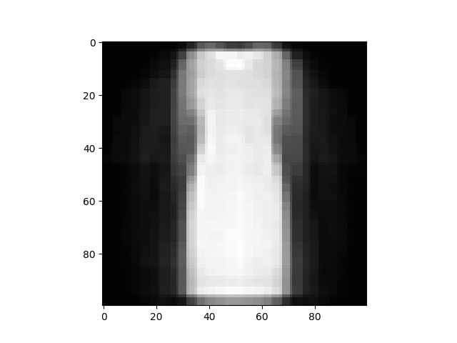
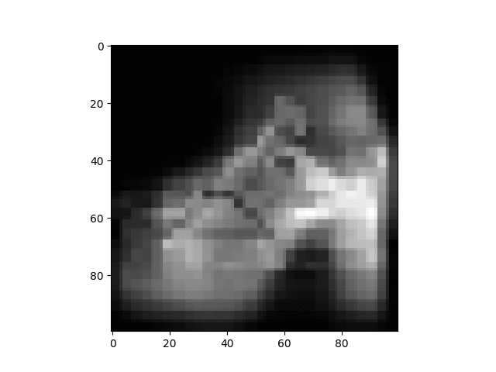
Fashion MNIST
Sandals to Sneakers
Dress to long-sleeved shirt
Notes:
Here we explore the use of the principal flow when the data consists of 2
Classes of data.
The fashion mnist data set contains images of clothing and shoes.
Then, the main source of variability here lies in the 2 different kinds of images.
Sure enough, we observe that the images on the principal flow transition from one class to another.
On the left, we can see the open high heels transition to sneakers,
and obtain a picture of an average kind of sneaker
As its outline becomes more and more defined. And indeed we can also see
the outline of the shoe flattening from a High heeled sandal into a sneaker.
The high heels gradually change shape, taking on the shape of different sandals and shoes
Going through sandals with a lower heel, to a shoe whose bottom part seems raised at both the toe and heel
Until it more closely represents the silhouette of the average sneaker.
We can see the animation on the right start from a short sleeved dress and slowly “grow” sleeves
And become a clearer picture of a long sleeved shirt before darkening
and the outline of the shirt sharpening into focus.
This indicates that the flow has found some kind of link between the
2 classes of images, and indeed the shirt can be made
From a dress if its sides were less form fitting and the sleeves extended,
which is exactly how the flow seems to indicate it transitioning.
Thus, with 2 classes of images, the flow describes the variability of the data by showing the transition
From one class of images to another.

Slide 42
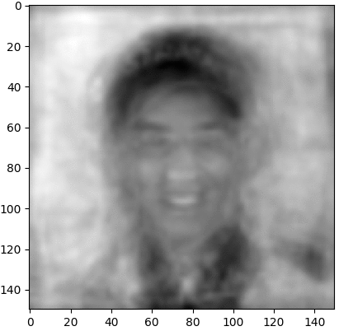
Faces in the Wild
Variability in skin color, hair/cap, background lighting, formal/casual outfit.
Skin tone, expressions transition to one another.
Notes:
Finally we test our algorithm on the faces in the wild dataset, which consists of
pictures of real people in outside environments.
We start with an image of a darker skinned man with smaller eyes, and watch
The images change as we travel along the principal flow: his smile turns into someone else’s
Lips, and his eyes get bigger. the faces gradually change from one expression to another,
And one skin tone to another.
We also observe that the subjects’ hair changes into a cap for some, and
the background lighting also seems to shift: from light to dark, going along with skin tone.
What’s more, we notice that the transition between faces is relatively smooth,
as if the images were arranged and then blended together.
This Is more support for the idea that the use of the hypersphere as our manifold yields an embedding which ties back to some real world meaning, since faces that are similar are again close to each other.
Thus we can see that the flow is able to showcase the rich variability in the data set:
Differences in expression, facial features, skin tone and background lighting, .

Slide 43
Future work
Notes:
Now we move on to the results of applying our greedy principal flow.

Slide 44
Flow of Presentation
Motivation
Definitions
Literature Review
Principal Flow Algorithm
Results
Future Work
We are here

Slide 45
Future Work
K-th order Principal Flows
Mapping data to different choices of manifolds
Greedy Principal Boundary as a maximal margin classifier

Slide 46
THANK YOU

Slide 47
EXTRA SLIDES

Slide 48
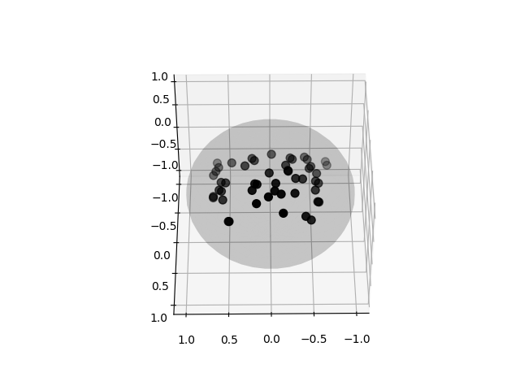
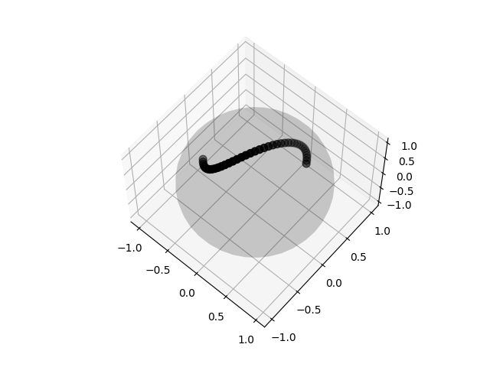
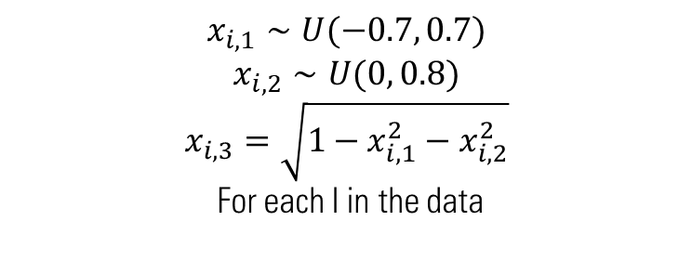
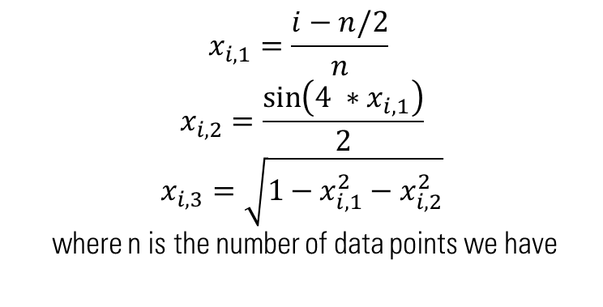
Toy Data Generation - examples
$$x_{i, 1}=\frac{i−n/2}{n}$$
$$x_{i, 2}=\frac{\sin\left(4 ∗x_{i,1}\right)}{2}$$
$$x_{i, 3}=\sqrt{1−x_{i,1}^{2}−x_{i,2}^{2}}$$
where n is the number of data points we have
$$x_{i, 1}∼U(−0.7, 0.7)$$
$$x_{i, 2}∼U(0, 0.8)$$
$$x_{i, 3}=\sqrt{1−x_{i,1}^{2}−x_{i,2}^{2}}$$
For each I in the data

Slide 49
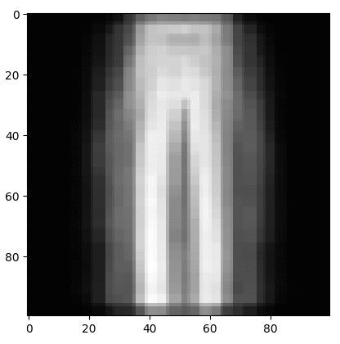
Extra Fashion MNIST
Dress to Trousers

Slide 50
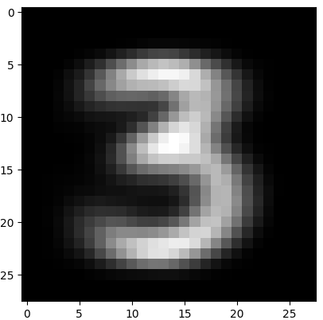
MNIST using PCA
No variation present in pictures
Even with step sizes 0.01-2
Notes:
Here we also demonstrate MNIST with PCA:
We take the MNIST data as is and find the mean image of the 3 digit, then we find the principal direction of the data set,
And move.
We find that there is little to no variation in the pictures, using a variety of step sizes.

Slide 51
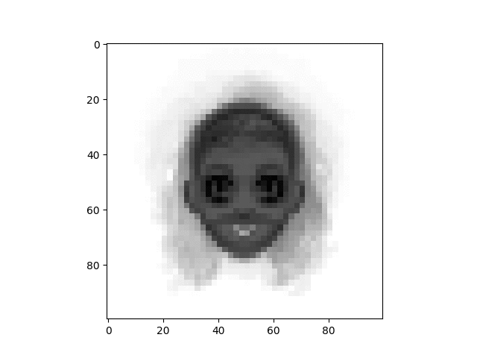
Cartoon Faces
Differ mostly on skin color, hair color and eye color.
Seems to be less long haired cartoon faces than short haired.
Notes:
This is a simple illustration of the flow on artificial faces
Here we can see the principal flow picks up the main source of variability:
Long hair, skin color hair color and eye color

